Slide 1
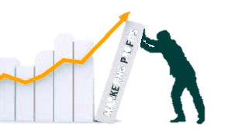
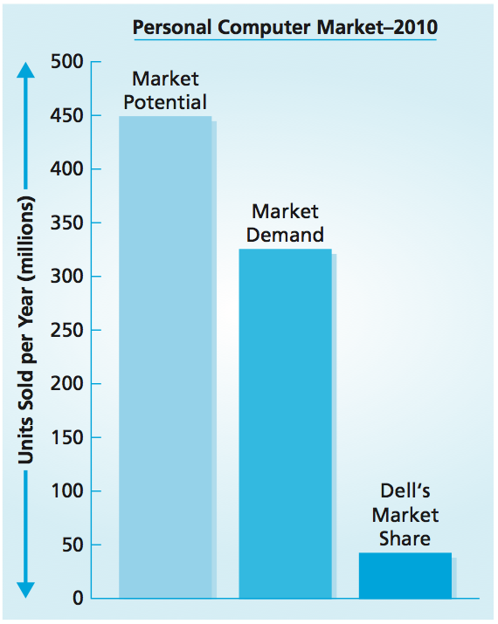
Market-Based Management
MBM6
Chapter 3
Chapter 3
Defining Market Space and Estimating Market Potential
Understanding Dynamics of Market Demand and the Product Lifecycle
Understanding How Market Share is Achieved and Evaluating Share Strategies
A narrow market definition limits your business opportunities. You have to see more to sell more.
—Jack Welch, CEO, 1981–2000 General Electric
Copyright Roger J. Best, 2012

Slide 2
Customer Focus, Customer
Performance, and Profit Impact
MBM6
Chapter 3
Defining Market Space and Estimating Market Potential
In this section we will look at how the greatest threat to a business’s survival—and a major cause of missed market opportunities—is a narrow focus on existing product-markets.
Copyright Roger J. Best, 2012

Slide 3
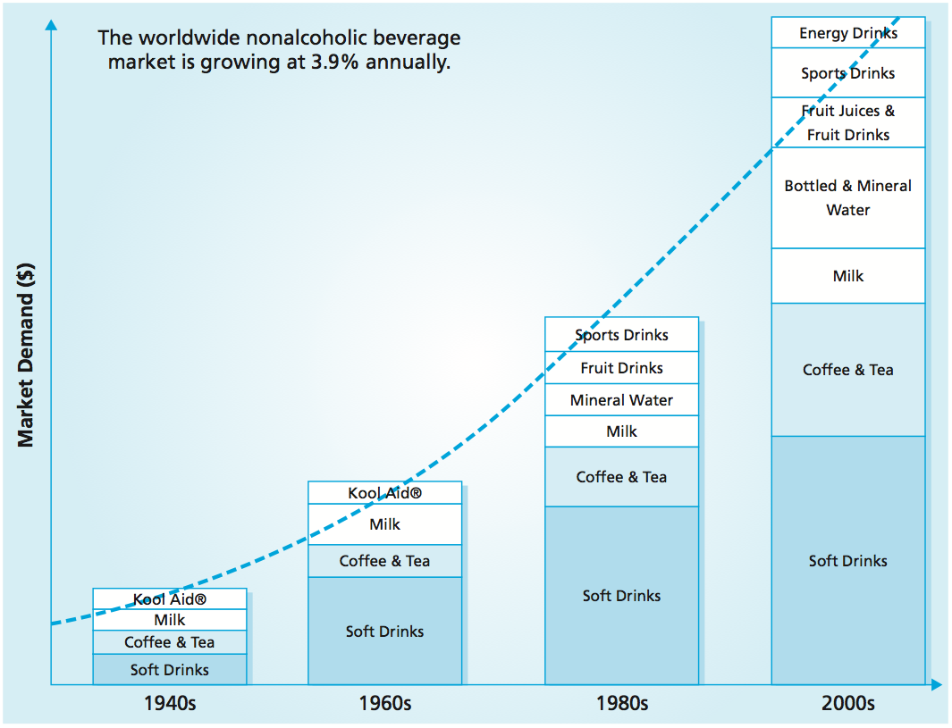
Product-Market Structure
MBM6
Chapter 3
Forty years ago, several of these products did not exist, while others had not yet reached their tipping point.
Copyright Roger J. Best, 2012

Slide 4
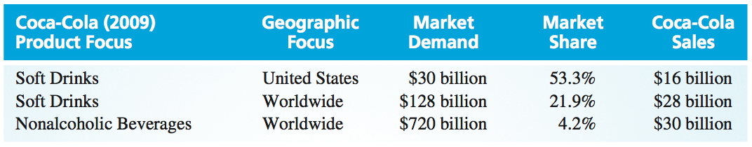
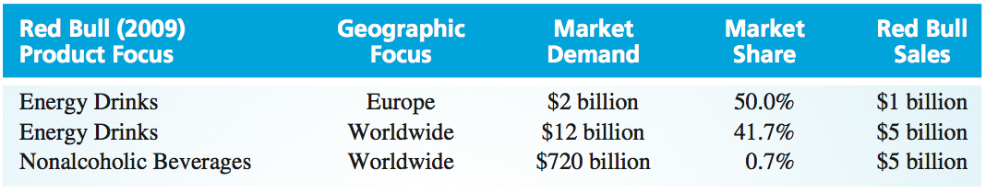
Market Definitions
MBM6
Chapter 3
A broad market definition is essential for any business in order to understand and measure market demand, market potential, and market share.
A narrow market definition, one adopted by design, is not always a limitation.
Copyright Roger J. Best, 2012

Slide 5
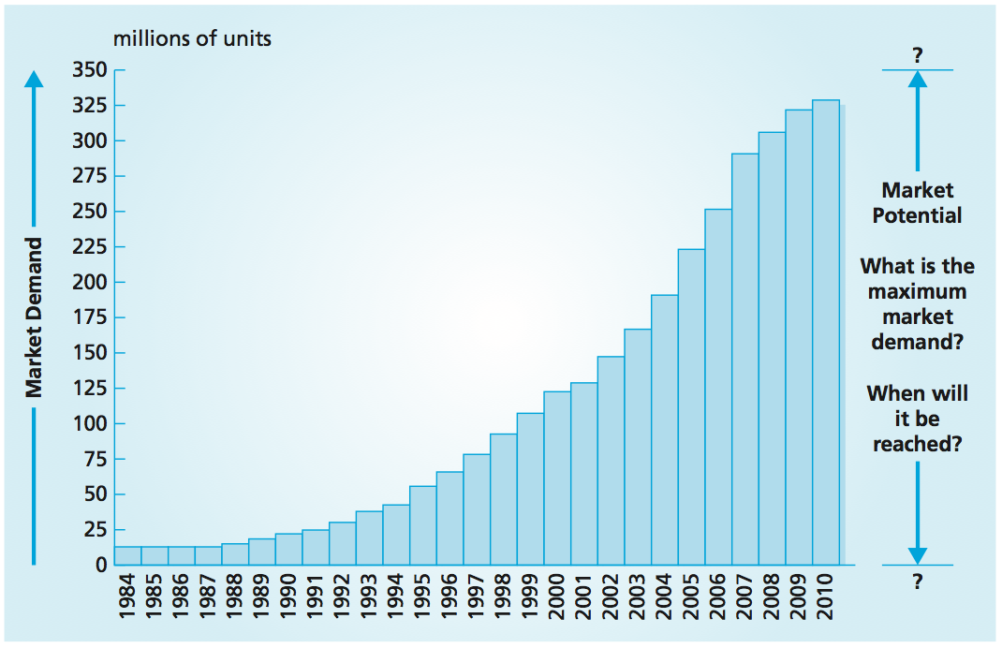
Personal Computer Market Demand
MBM6
Chapter 3
Knowing the maximum number of units that can be consumed by the defined market is of great strategic importance to a business: After a market reaches its full potential and saturates, new customers will be hard to find.
Copyright Roger J. Best, 2012

Slide 6

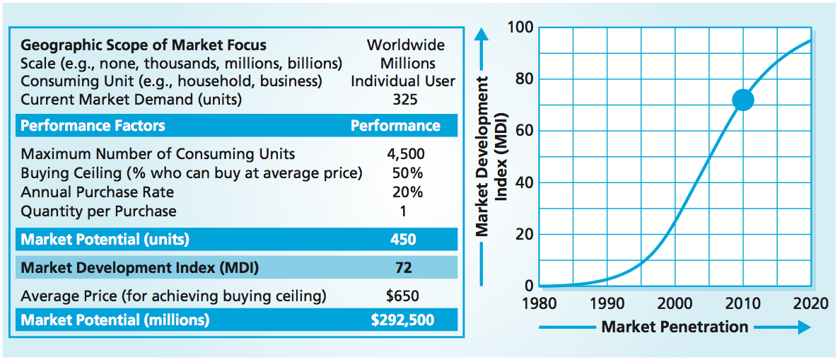
Marketing Performance Tool 3.1
Estimating Market Potential - PCs
MBM6
Chapter 3
The first step is to define the geographical boundaries and the consuming units. The consuming units could be defined in terms of individuals, families, households, businesses, or other purchasing entities.
Copyright Roger J. Best, 2012

Slide 7
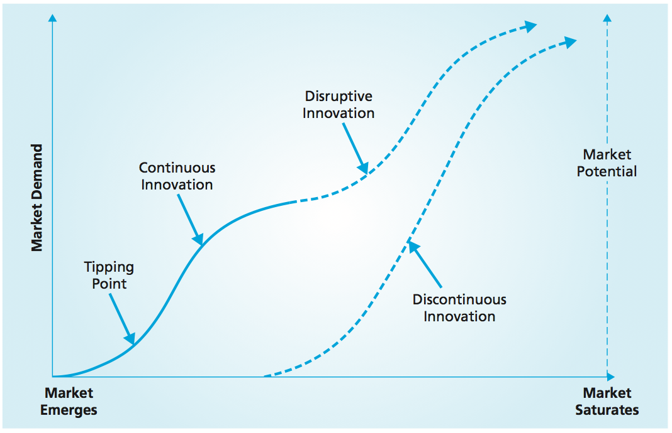
Innovation and Market Potential
MBM6
Chapter 3
New technology application essentially goes unnoticed until it reaches a tipping point, then develops more rapidly through continuous innovation.
In order for the market to develop further, there must be a disruptive innovation or a discontinuous innovation.
Copyright Roger J. Best, 2012

Slide 8
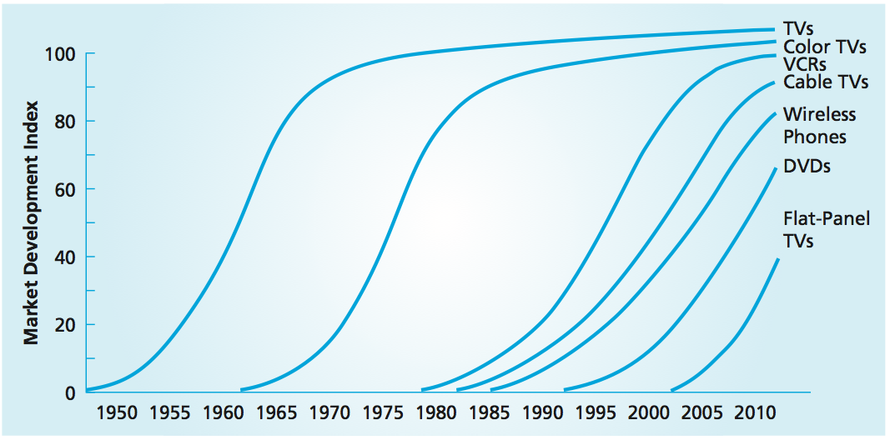
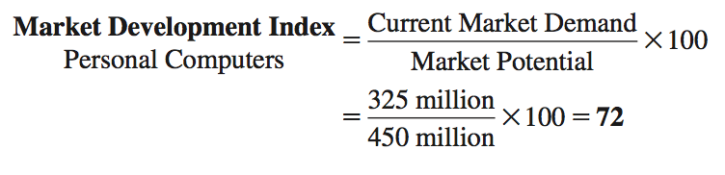
Market Development and Potential
MBM6
Chapter 3
Each of these products had a well-defined tipping point, followed by periods of rapid growth and eventually a leveling-off period as market demand approached its market potential.
Copyright Roger J. Best, 2012

Slide 9
Customer Focus, Customer
Performance, and Profit Impact
MBM6
Chapter 3
Understanding Dynamics of Market Demand Throughout the Product Lifecycle
In this section we will look at how understanding market demand over time is an important aspect of market planning and strategy development.
Copyright Roger J. Best, 2012

Slide 10
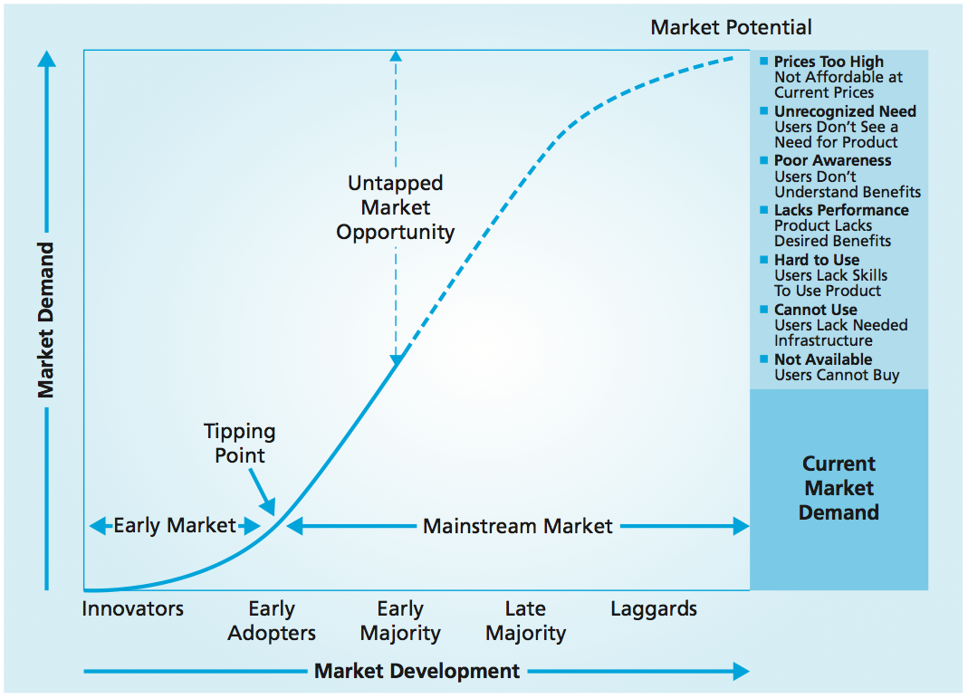
Factors of Market Development
MBM6
Chapter 3
Many new markets and most global markets are well below their market potentials because large numbers of potential customers have not yet entered them.
Copyright Roger J. Best, 2012

Slide 11
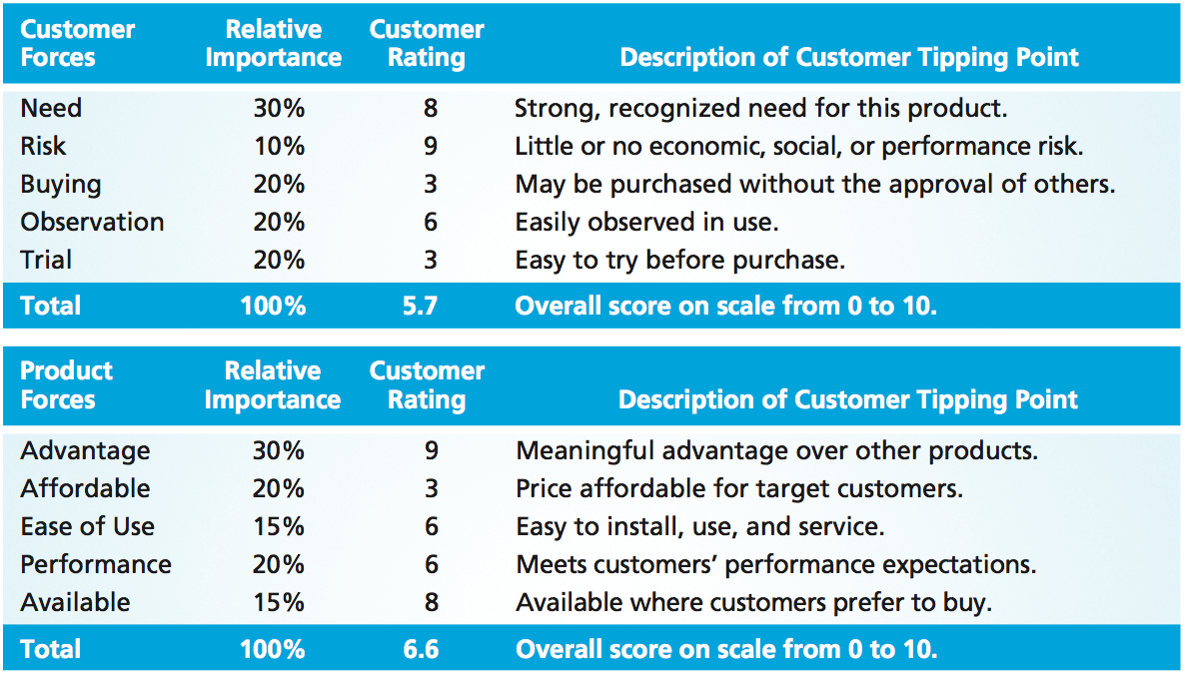
Forces that Shape Market Growth
MBM6
Chapter 3
Developing and delivering a complete solution requires more than improving the product and making it affordable to the mainstream market.
Copyright Roger J. Best, 2012

Slide 12
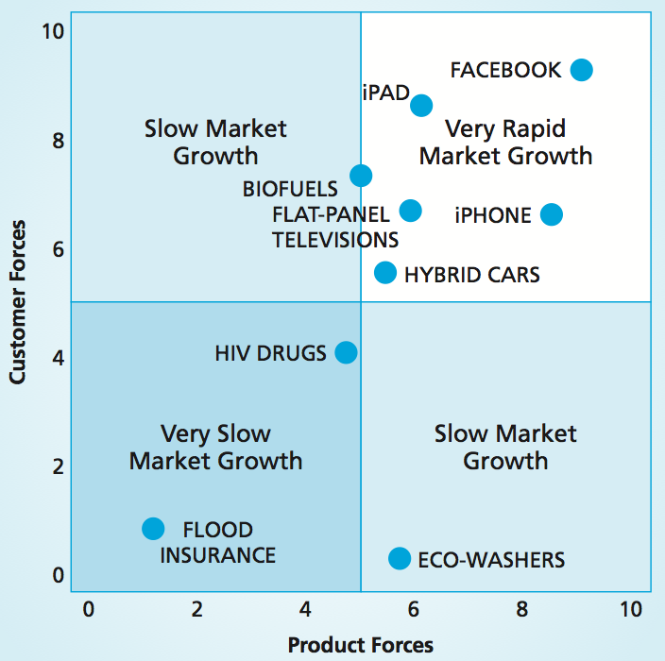
Forces Driving Market Growth
MBM6
Chapter 3
Products or services with weak overall scores for both customer forces and product forces experience very slow market growth.
The best results naturally occur when both the customer forces and the product forces are strong overall.
Copyright Roger J. Best, 2012

Slide 13
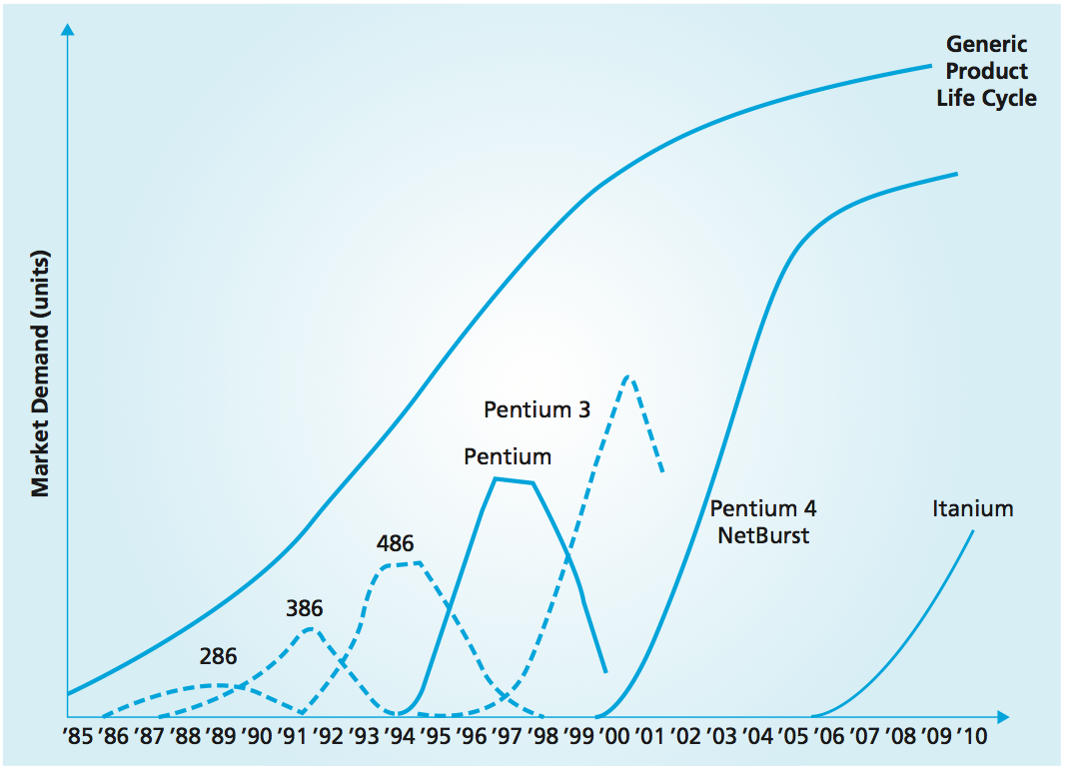
Product-Market vs. Product Life Cycle
MBM6
Chapter 3
As the personal computer market has grown, along with the demand for greater speed and capacity, Intel has gone through entire product life cycles for several products, as the graph illustrates.
Copyright Roger J. Best, 2012

Slide 14
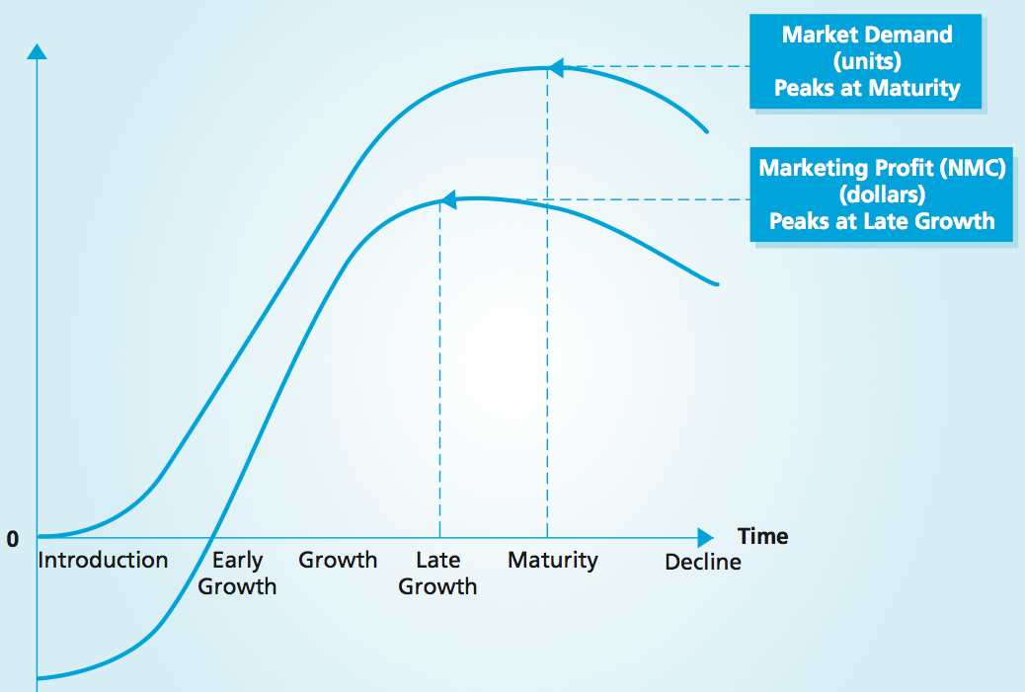
Product Life Cycle, Market Demand, and Profits
MBM6
Chapter 3
In the early stages of the product life cycle the net marketing contribution (NMC) is negative. As the product moves through the lifecycle, NMC will reach break-even, grow, peak, flatten, and begin to decline as market demand decreases.
Copyright Roger J. Best, 2012

Slide 15
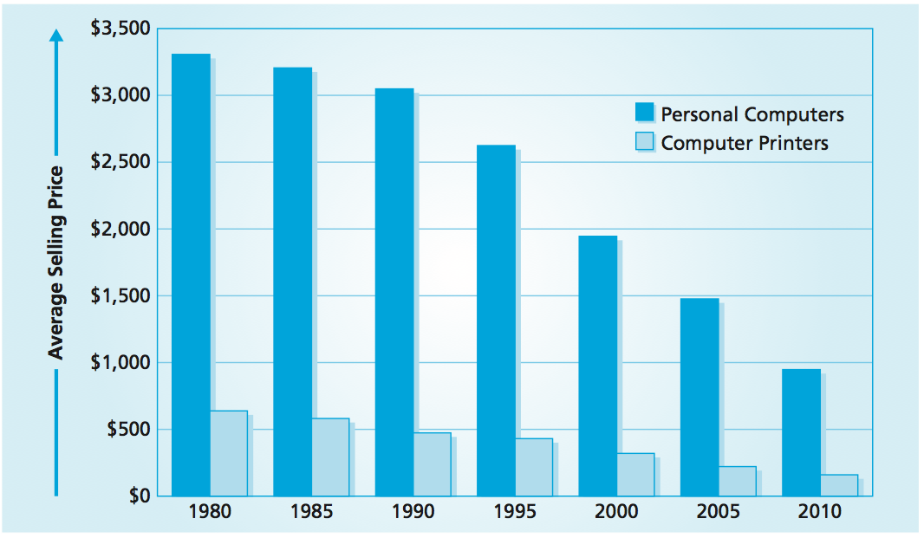
Average Selling Price
MBM6
Chapter 3
One of the reasons that demand grows as a product moves through the growth stages is an ongoing decline in the average selling price of the product.
Copyright Roger J. Best, 2012

Slide 16
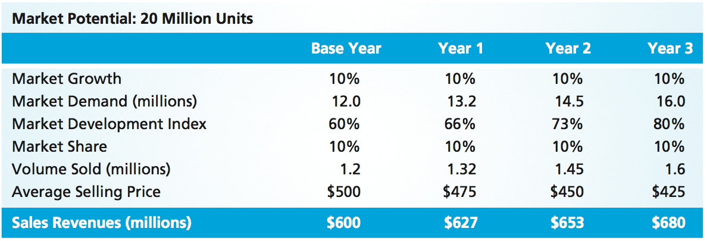
Estimating Product Life-Cycle Demand and Sales
MBM6
Chapter 3
Recognizing that volumes grow and prices decline in the growth stages of the product life cycle, we can estimate future market demand and the MDI by projecting the assumed market growth rate over a 3-year planning period.
Copyright Roger J. Best, 2012

Slide 17
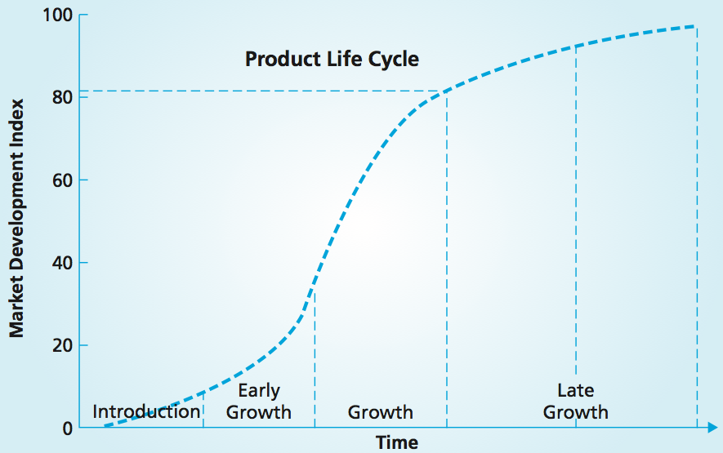
Estimating Growth for Market Demand and Sales
MBM6
Chapter 3
One of the benefits of estimating market potential is the ceiling it places on market demand. Businesses that have enjoyed years of growth will often project continued growth beyond the market potential.
Copyright Roger J. Best, 2012

Slide 18
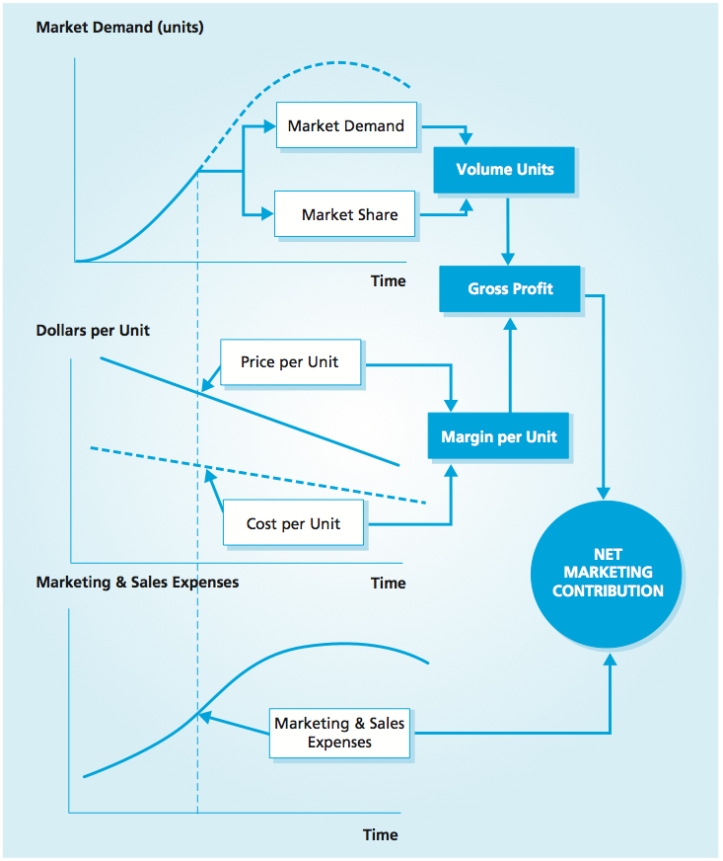
Life-Cycle Demand, Margins, and Marketing and Sales Expenses
MBM6
Chapter 3
Volume grows while the average price declines over the product life cycle
Prices tend to decrease faster than unit costs decrease
Margins per unit tend to decline over the product life cycle
MSE increase over the introductory and early growth phases of the product life cycle
MSE as a percentage of sales tend to level off as a product approaches the maturity stage, and they decrease during the decline stage
Copyright Roger J. Best, 2012

Slide 19
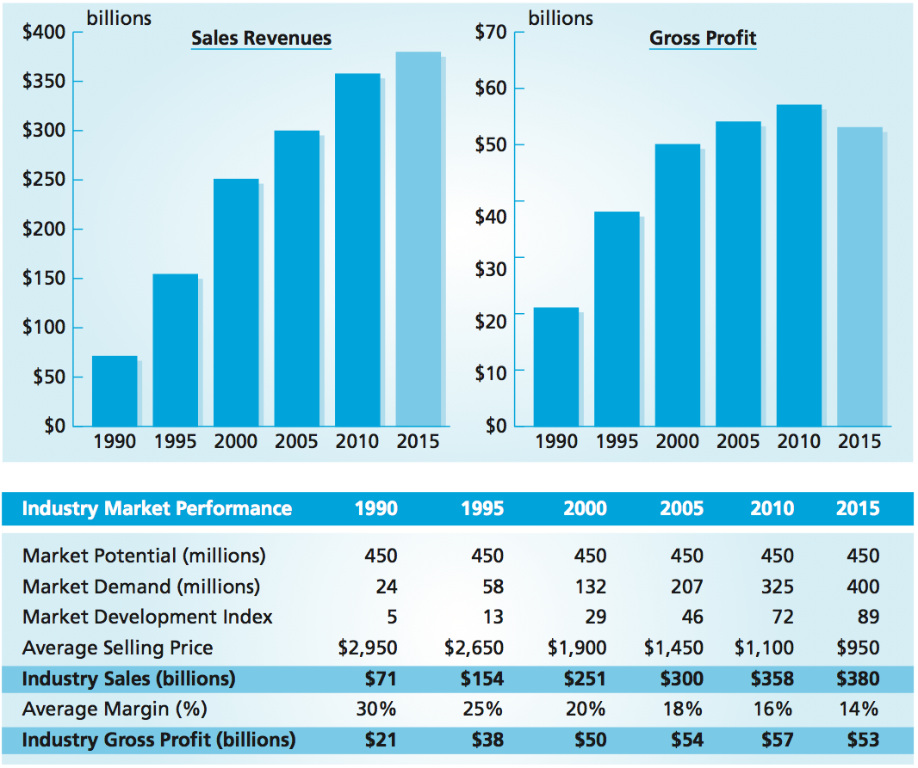
Marketing Performance Tool 3.3
PC Life-Cycle Sales and Gross Profit
MBM6
Chapter 3
Profits can vary over the product life cycle.
For PCs, we see continued growth beyond the late growth stage in both sales revenues and market demand in units.
Slower growth in volume and declining prices will contribute to lower margins and lower industry gross profits.
This modest decline occurs as the PC market moves from late growth to the maturity stage.
Copyright Roger J. Best, 2012

Slide 20
Customer Focus, Customer
Performance, and Profit Impact
MBM6
Chapter 3
Understanding How Market Share is Achieved and Evaluating Share Strategies
In this section we will look at how, for a given market and the market’s potential for development, a business can determine its best opportunities for sales growth, depending on its potential to grow share.
Copyright Roger J. Best, 2012

Slide 21
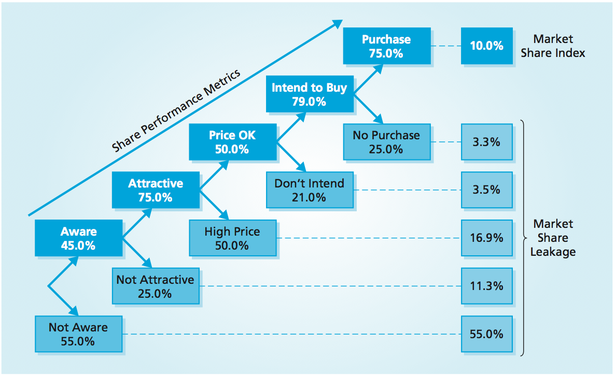
Marketing Performance Tool 3.2
Market Share Performance Tree
MBM6
Chapter 3
Moving from bottom to top, each stage of the market share performance tree indicates how the customer response to a strategy influences market share. The first step is to identify the sequence of events that have to take place for a customer purchase to occur.
Copyright Roger J. Best, 2012

Slide 22
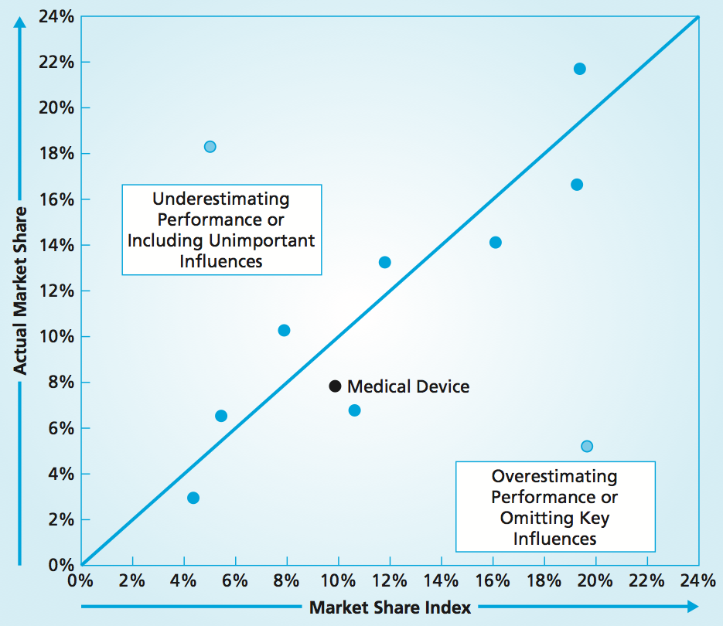
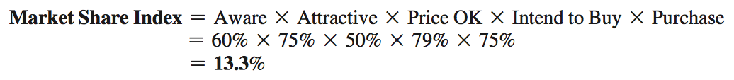
Market Share Index vs Actual
MBM6
Chapter 3
Benefits of MSI:
Helps identify the major causes of lost market share opportunity
Provides a mechanism for assessing market share change when improvement efforts are directed to an area of poor performance
Enables a business to estimate a reasonable potential for its market share
Copyright Roger J. Best, 2012

Slide 23
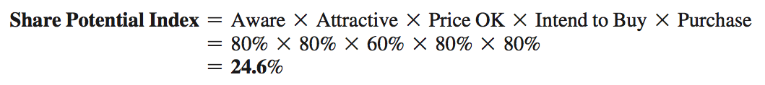
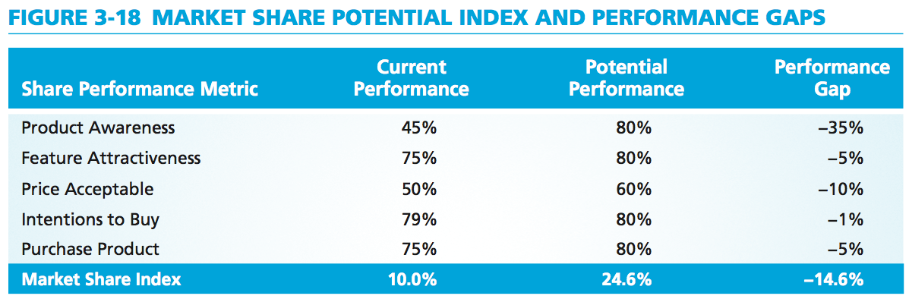
Market Share Potential Index
MBM6
Chapter 3
Establishing a desired level of response at each level of the performance tree provides a basis for estimating market share potential.
For each level of the tree, the share performance gap indicates the extent of lost market share due to the lower customer response rates.
Copyright Roger J. Best, 2012

Slide 24
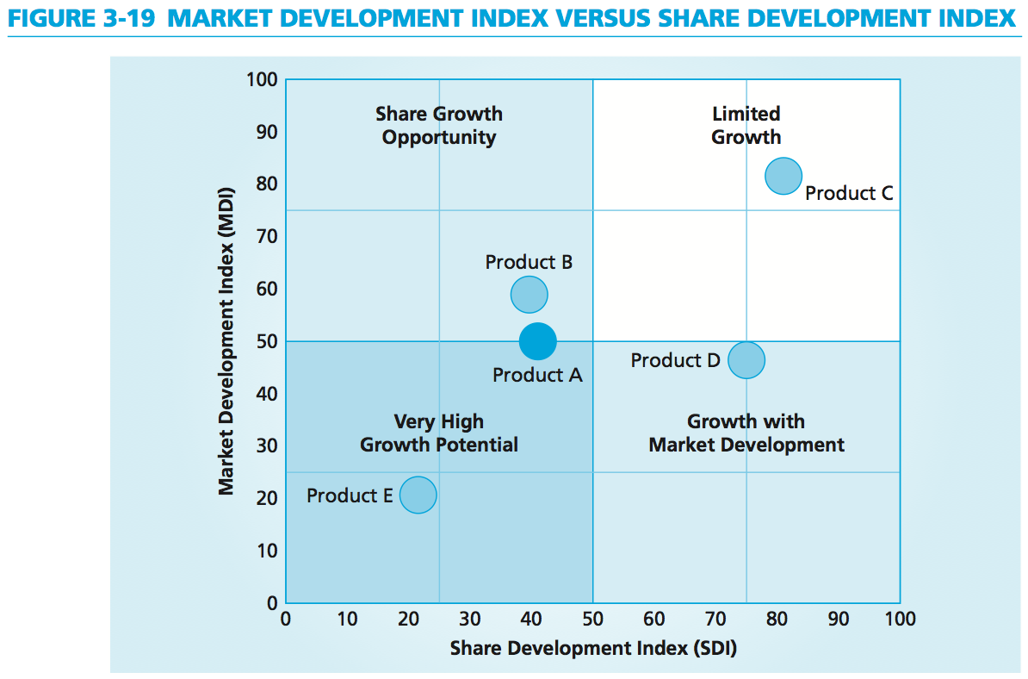
MDI vs SDI
MBM6
Chapter 3
By combining the Market Development Index (MDI) with the Share Development Index (SDI), a business can discover whether they should focus on market development or share development or both, depending on the product’s position in the growth opportunity portfolio.
Copyright Roger J. Best, 2012

Slide 25
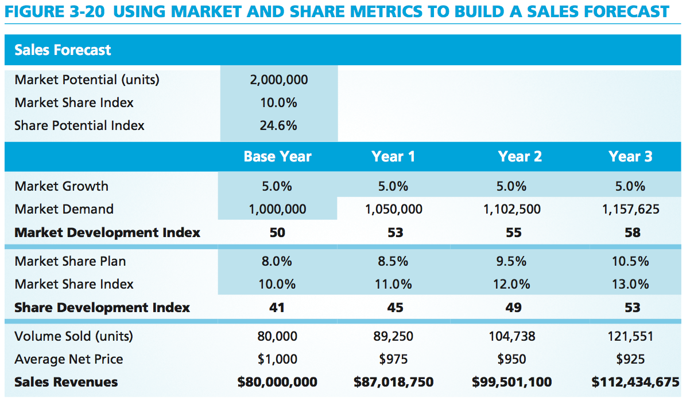
Using Market and Share Metrics to Build Sales Forecast
Marketing Performance Tool 3.4
MBM6
Chapter 3
Adding the MDI and SDI to a sales forecast provides a way to understand the potential for future sales growth. Above we see that there is plenty of market growth beyond year 3 of the sales forecast.
Copyright Roger J. Best, 2012

